Slide 1



FCI MODEL FOR THE WETTERHOUN
POWERPOINT PRESENTATION OF YOUR FCI RECOGNIZED NATIVE BREED(S)
(FCI General Committee, Helsinki, October 2013)
(FCI Show Judges Commission, Cartagena, February 2013)

Slide 2

Wetterhoun
FCI Group 8 Breed number 221
Date of publication of the official valid standard 05/02/1999

Slide 3

Multipurpose dog from the poor farmers.
Used as an all round hunting dog, guarding the yard, keep the yard free from mice and rats and has a great reputation for catching otters and polecats. Also was used to pull dog cars.
Origin in Friesland, the northern part of Holland, and during the beginning of the 20th century crossbred with the Stabijhoun (the other Frisian breed).

Slide 4
Because of the crossbreeding, we almost lost two unique breeds.
First breeding standard in 1944.
At this moment most of the Wetterhoun are pets and (family)guard dogs
Some dogs are used for hunting. Because of their independent and somewhat stubborn nature, you must be patient and consistent.

Slide 5

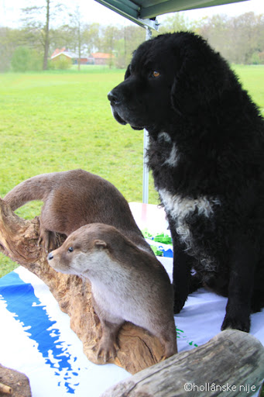
Hunting dog and guard dog
Also, because of his coat, not
comfortable in extreme heat.
Famous for the otter catching.
(this is not permitted anymore)
The character for this should
be tough and “diehard”.

Slide 6
The Wetterhoun is obedient, but not so easy.
He is very independent. With training you must
have patience. He’s definitely not servile.
In the beginning he can be a bit reserved, a bit a “one person dog” but when he knows you, everything is all right.
When judging, approach them gently and it’s okay. The Wetterhoun should not be nervous or fearful.

Slide 7

GENERAL APPEARANCE
A well balanced dog, traditionally used for otter
hunting. A sturdy animal, but neither plump nor
clumsy, square and thick set in overall build, with
close fitting skin, free from throatiness or dewlap.
Lips not pendulous.
Sturdily built is important and we see this frequently
in the breed standard.
The Wetterhoun has a bit of a molosser look.

Slide 8
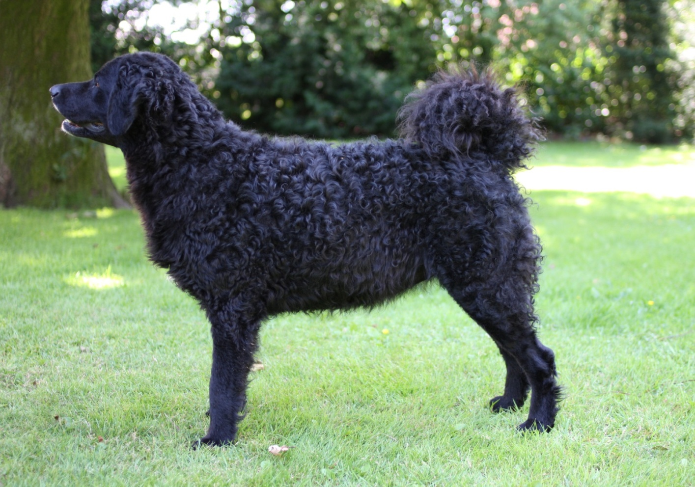
Square body proportions

Slide 9
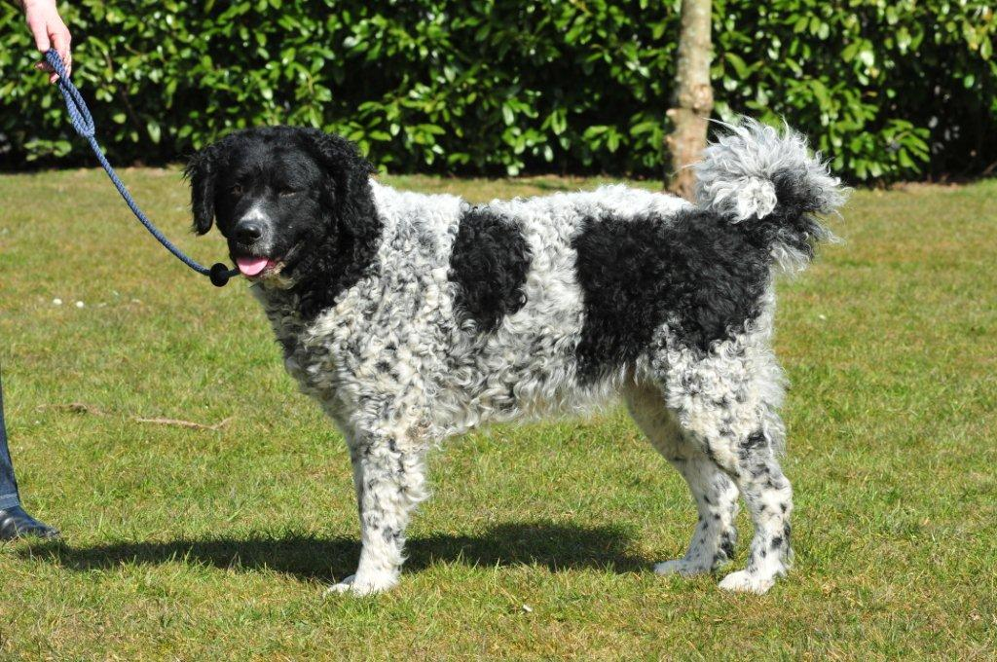
Too stretched

Slide 10
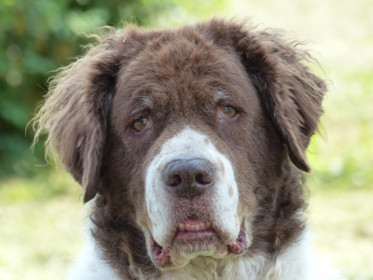
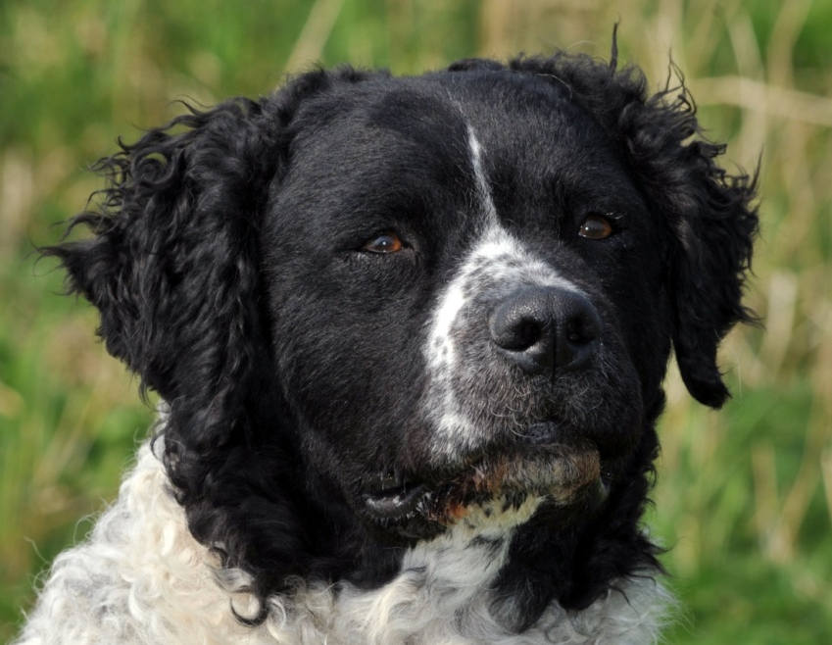
Heavy head with dewlaps Dry head
without folds or dewlaps

Slide 11
BEHAVIOUR / TEMPERAMENT
Quiet dog with stubborn character,
reserved about strangers, an ideal guard-dog.
They are devoted, gentle and intelligent, but also
independent. For training you must have patience,
but they can be very good hunting dogs.

Slide 12
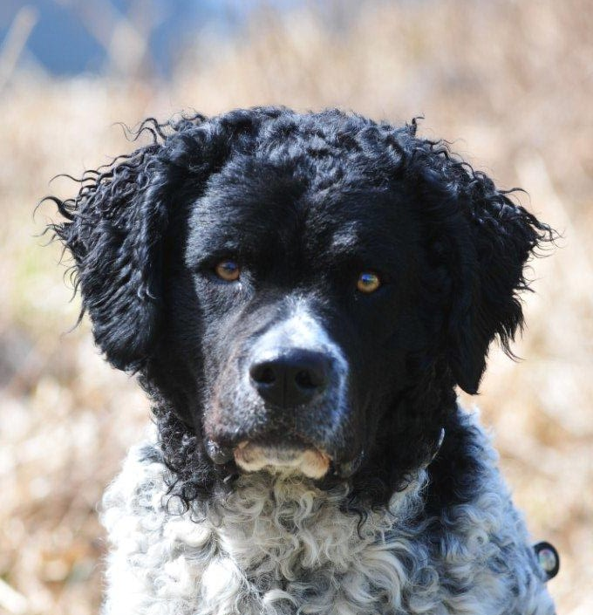
HEAD
Dry, size in balance to the body,
strong and powerful.

Slide 13
CRANIAL REGION :
Skull:
    Slightly rounded, giving the impression of being wider than long, gently sloping into the cheeks. Skull and muzzle of the same length.

Slide 14
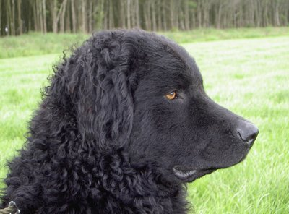
Don’t take the remark about the muzzle
and the skull of the same length too serious.
The muzzle can be a little smaller.
Good proportions muzzle and skull

Slide 15
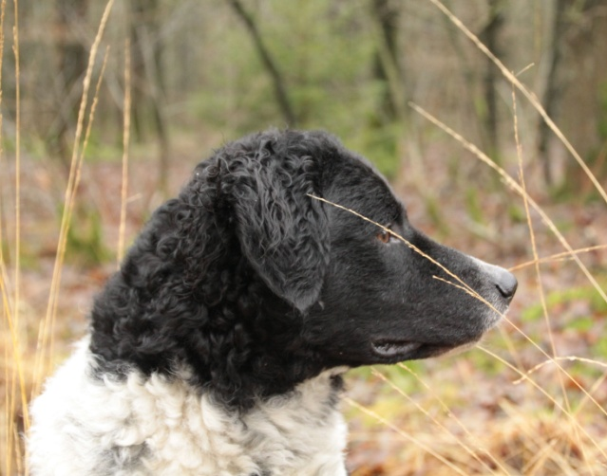
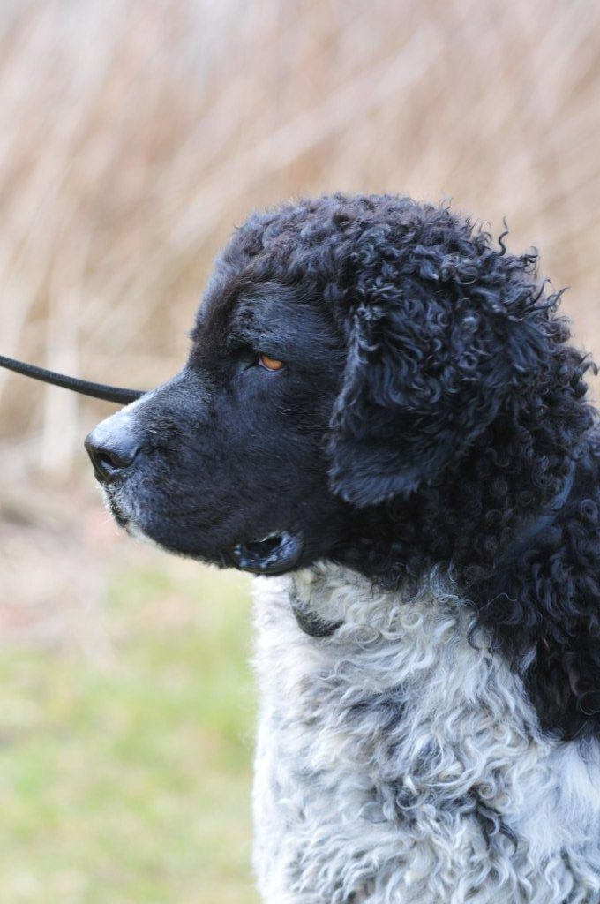
Muzzle a bit too long Muzzle too short

Slide 16
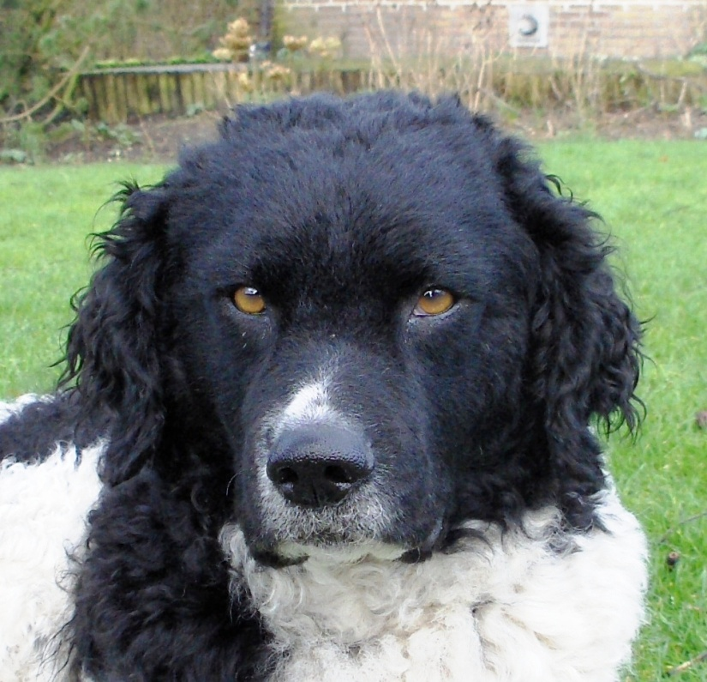
Good shape of the skull

Slide 17
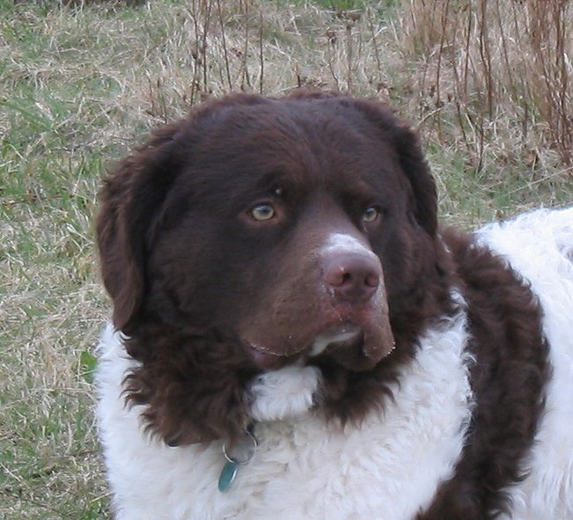
skull too round skull too broad

Slide 18
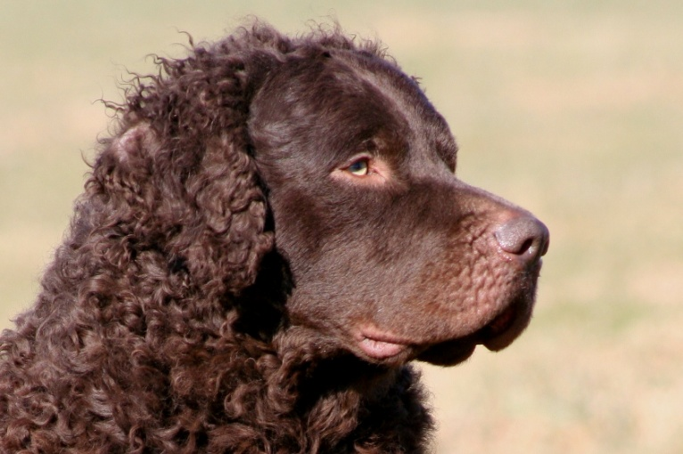
Stop:
The skull falls gently away into the foreface,
stop only slightly indicated.
Good Stop

Slide 19
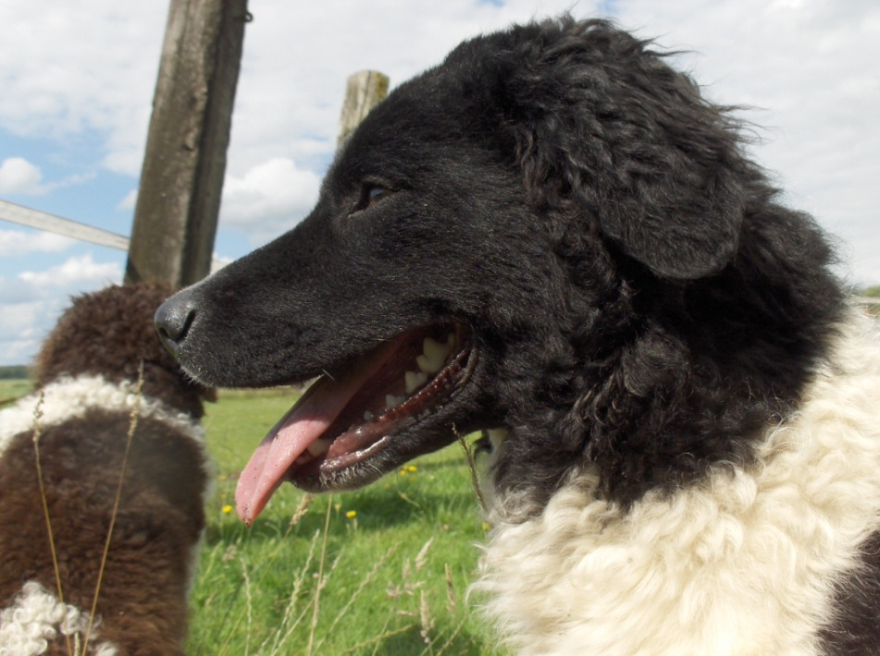
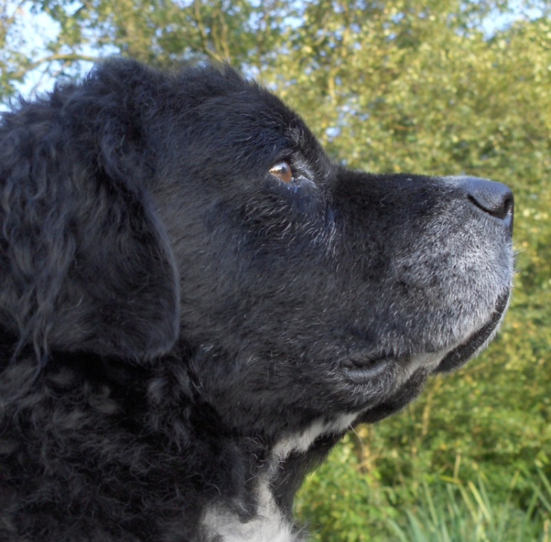
Stop:
Stop too little Too abrupt, deep stop

Slide 20
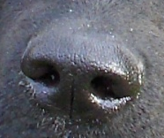
FACIAL REGION :
Nose
Well developed, not split.
Black for dogs with black
ground colour and brown
for dogs with brown ground
colour.
Nostrils well developed and open.

Slide 21
FACIAL REGION :
Muzzle:
Powerful, tapering slightly to the nose, not pointed,
but truncated.
Nasal bridge broad and straight, neither concave
nor convex when viewed from the side.

Slide 22
The bridge of the nose should be nice and straight.
The last part, which is just cartilage, may be
drooping a bit. You can lift the nose tip to see and feel if the
nose bridge (the bone) is straight.
When rounding occurs, as we see in a rams-nose (convex)
or a dish-faced (concave) nose, it is less desirable.
The muzzle should be full, but tapering a little bit to the nose.

Slide 23
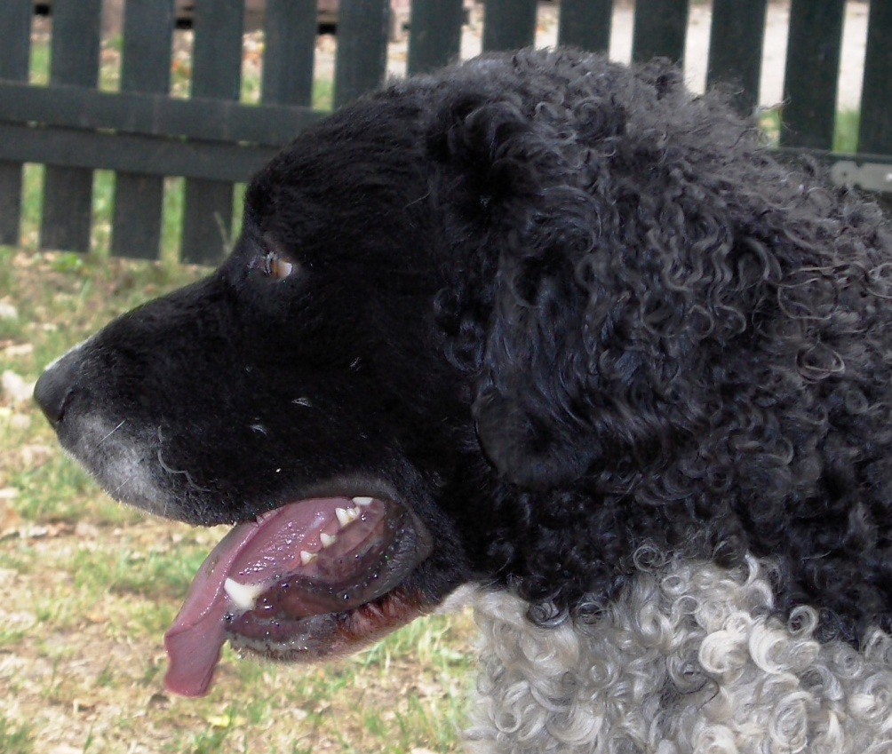
Nose bridge too convex

Slide 24
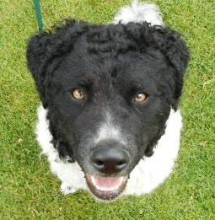
The muzzle should be full, but tapering a little bit to the nose.

Slide 25
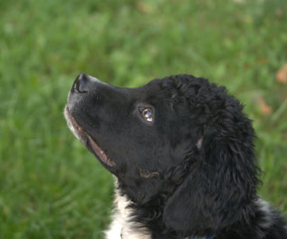
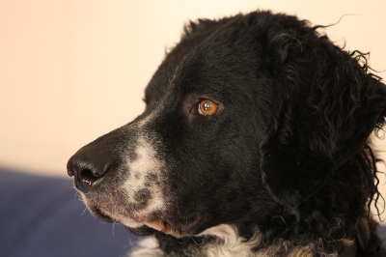
Lips: Tightly fitting, not overhanging.
Nice tight lips Lips a bit too pendulous,
but acceptable

Slide 26
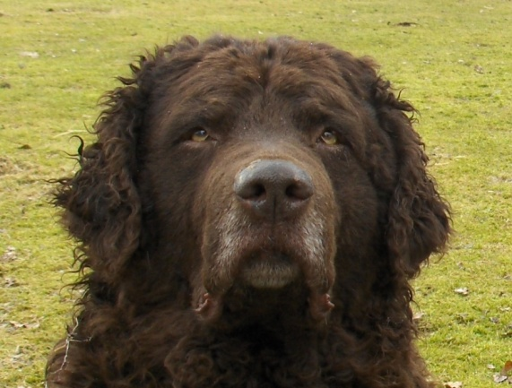

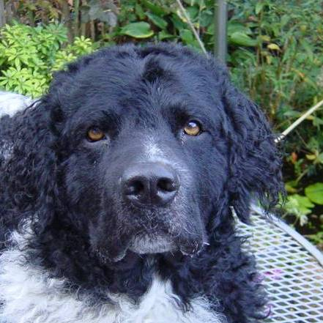
Too much lip. Not tight and too much overhanging.

Slide 27
FACIAL REGION :
Jaws/Teeth: Teeth powerful, scissor bite.
Cheeks: Musculature moderately developed.
Level bite is less desirable

Slide 28
Eyes
Of medium size, oval, with tightly fitting lids,
without showing the conjunctiva;
placed slightly slanting, causing a somewhat
grim expression.
They are neither bulging nor deep-set.
Colour dark-brown for dogs with a black ground
colour, and brown for dogs with a brown ground
colour. Bird of prey eyes are objectionable.

Slide 29
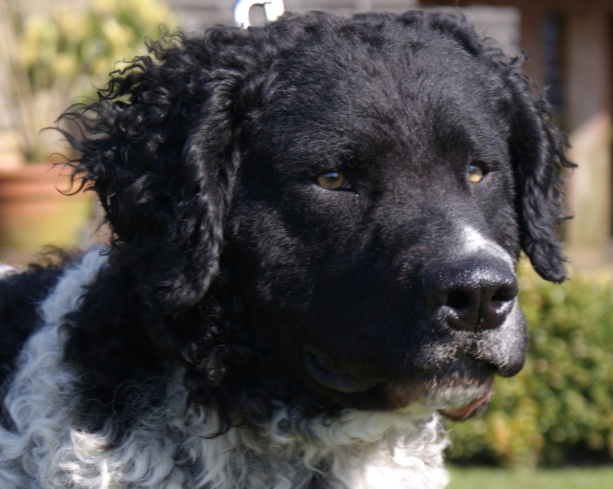
The grim expression
There is a lot of confusion
about the grim expression.
It sounds like the dog has
not such a nice temperament,
but it has nothing to do with
the character.
The place of the eyes (slightly slanted) and the form
(oval shaped) makes the grim expression.

Slide 30
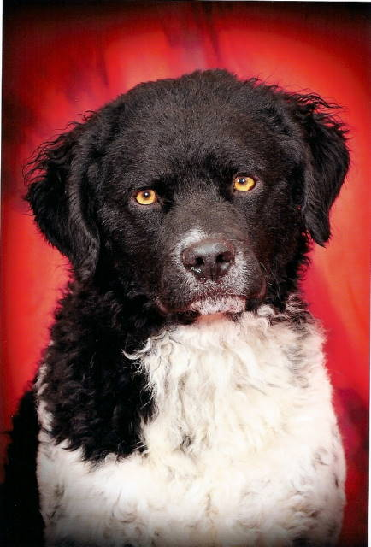
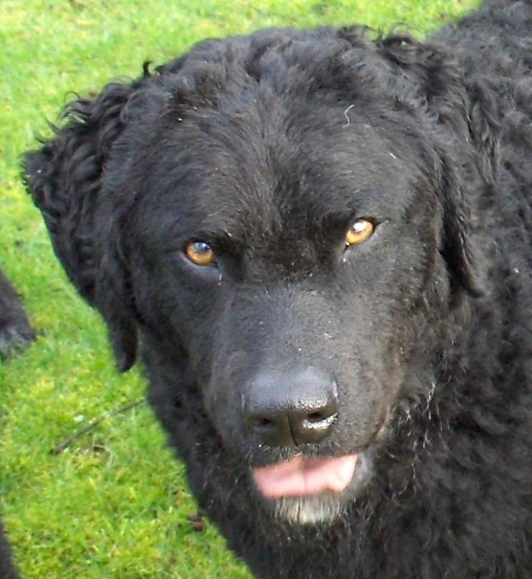
Eyes placed too horizontal Correct slightly slanted
in the head placed eyes
)

Slide 31
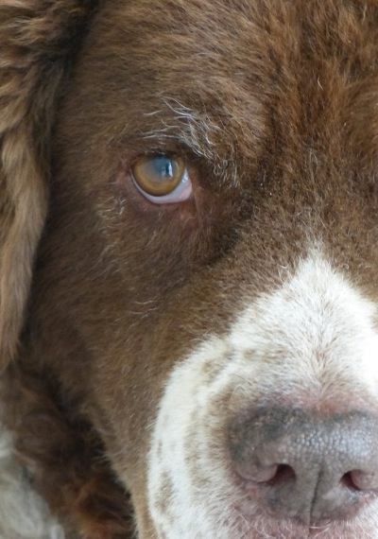
Good color of the
eye for brown

Slide 32
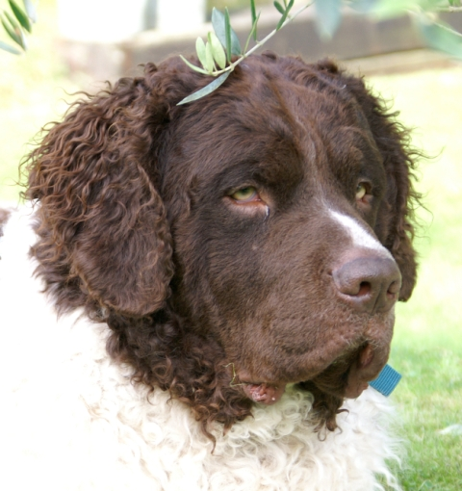
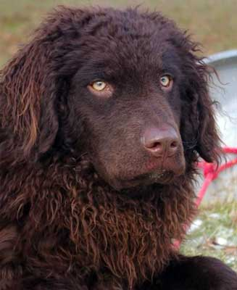
Acceptable color of the Too light color of the
eye for brown eye for brown

Slide 33
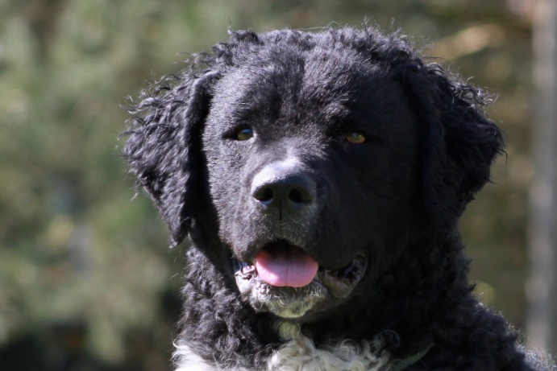
Good color of the
eye for black

Slide 34

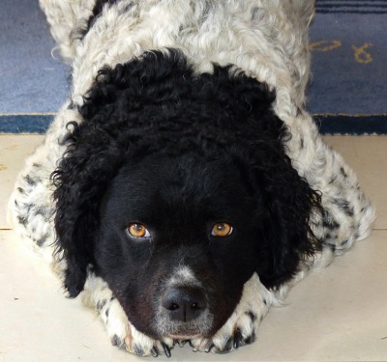
Acceptable color of the Too light color of the
eye for black eye for black

Slide 35
Leathers / ears
Set rather low.
The auricle is so little developed that ears hang flat
along the head without any break.
Objectionable are strongly developed auricles with
the break not immediately at the set, but further
down causing the ear lobe not to hang close to the
head.

Slide 36
Leathers / ears (2)
The ears are moderately long and have the form of
a mason’s trowel.
The coating of the ear is a typical characteristic of
the breed. It is curled, rather long at the set of
the ear, decreasing in length to the lower 1/3 part
where the ear is covered with short hair.

Slide 37

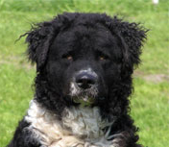
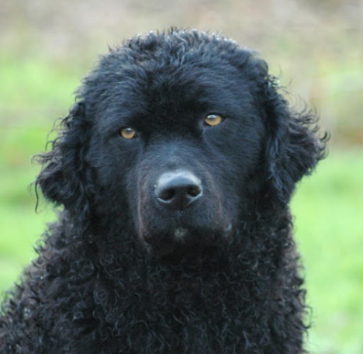
Ear set
And, of course, ask for the dog’s attention. When the ears
are perked up, the ears shouldn’t be higher than the skull.
Good earset Too high earset Too low earset

Slide 38
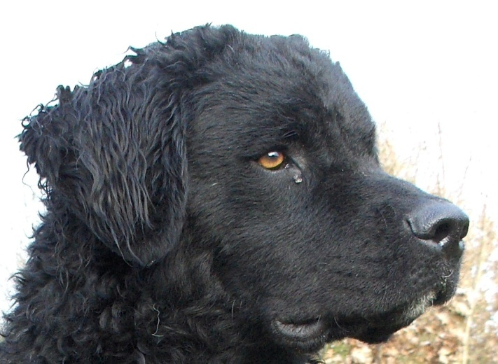
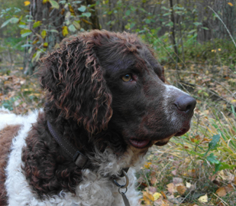
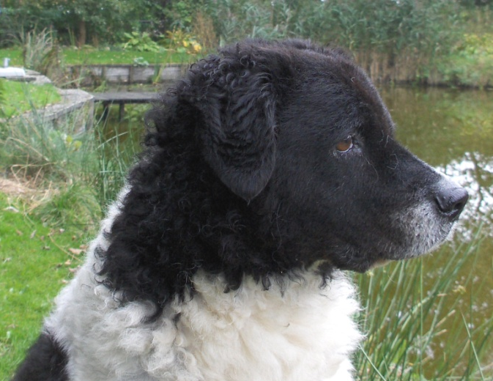
The ears are moderately long
Good length of the Ear a bit too long Ear a bit too short
ear

Slide 39
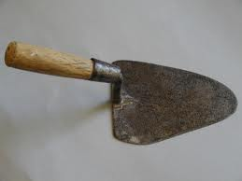
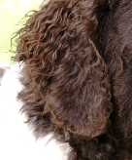
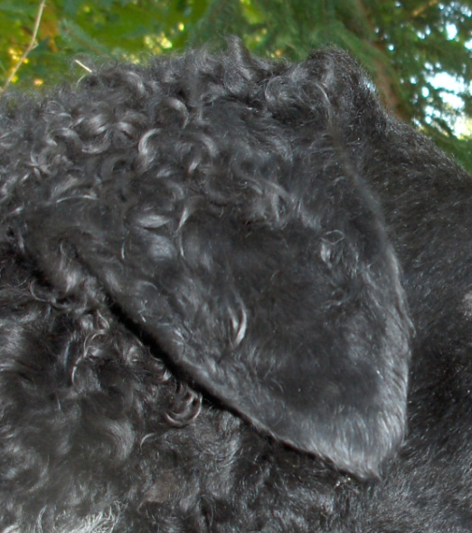
The ears have the form of a mason’s trowel.
Good form of A too round A bit to much of
the ear form of the ear the form of a point

Slide 40
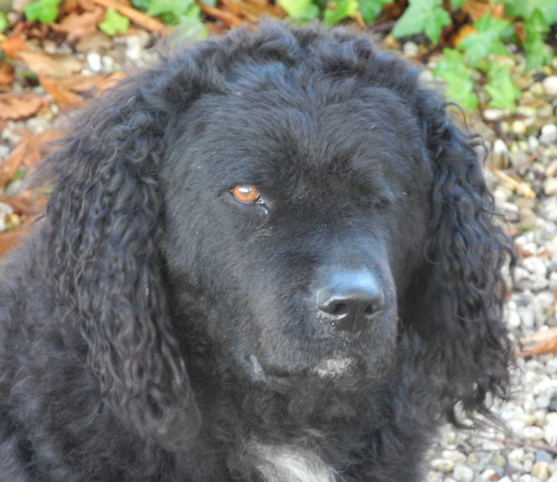
The fur on the underside of the ear should be short. The fur on the top side of the ear should not be longer than the ear itself, its length decreasing from the top of the ear to the tip.
You can easily trim any fur that hangs past the ear by plucking the fur; never by cutting with a scissor! The hair on the ear shouldn’t be longer than the ear itself.

Slide 41
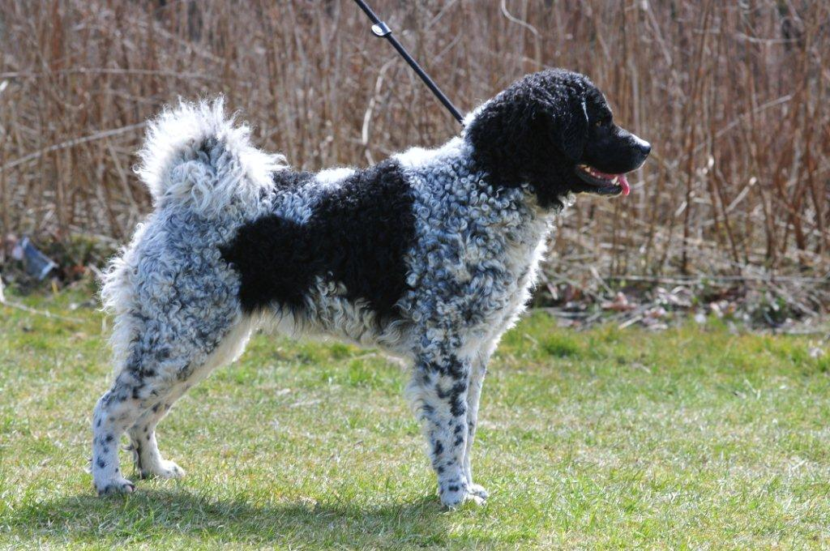
Neck
Short, strong, round, merging into
the topline in a very blunt angle,
i.e. the head is mostly carried low.
The neck slightly arched.
No throatiness or dewlap.

Slide 42
To fetch or kill the game, the Wetterhoun should have a
strong neck; not a long or an elegant neck.
The short neck that is called for in the breed standard
should not be taken too strictly. The neck should be sturdy.
A short neck is often an indication of a front that is placed
too far forward.

Slide 43
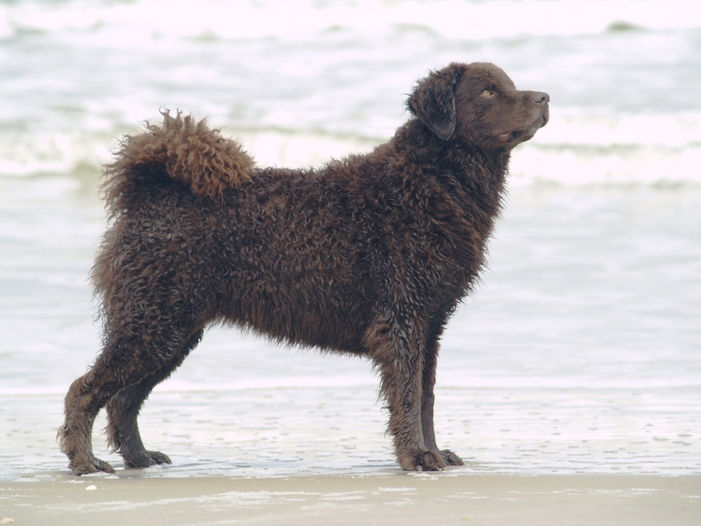
Body Very powerful.
Back : Short and straight.
Loin : Strong.
Croup : Only slightly sloping.

Slide 44
Chest
Wide, showing more width than depth, so that the
forefeet are rather wide apart, rounded, not reaching
lower than the elbow.
Ribs well rounded and well developed towards the
rear.

Slide 45
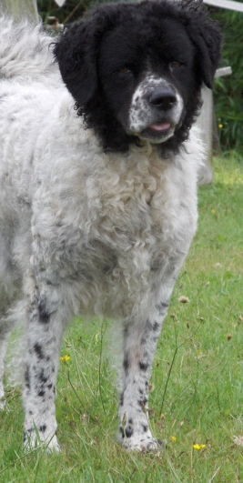
              The chest should be rather broad.
              The front legs are a bit wide apart, but must be under the body.
              The elbows should be close to the chest.

Slide 46
Underline and belly:
Only moderately tucked up.

Slide 47
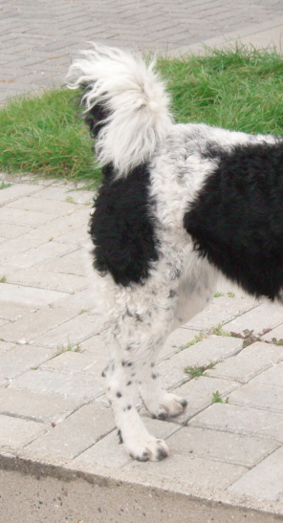
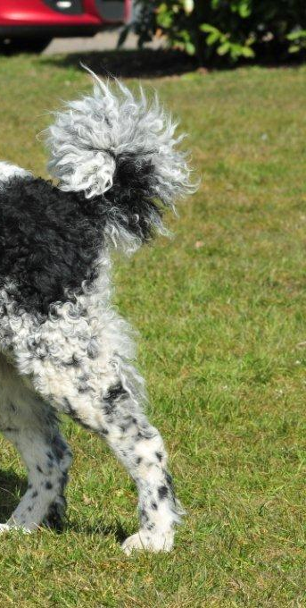
Tail
Long, carried as ring tail over or alongside
the croup.
The tail is the treasure of the Wetterhoun.
Here are some good tailsets

Slide 48
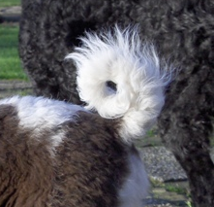
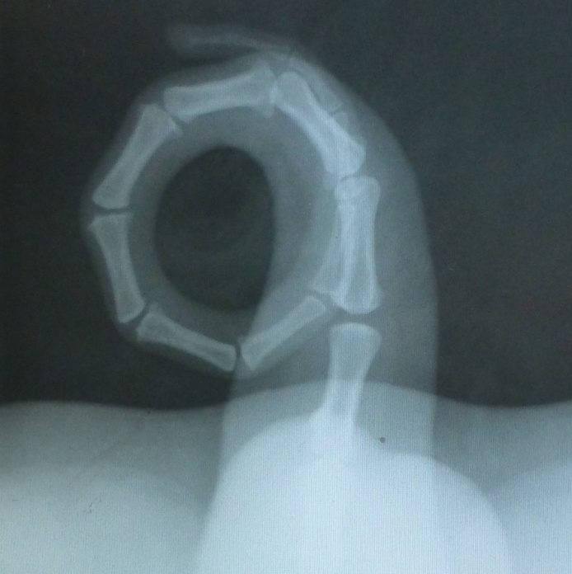
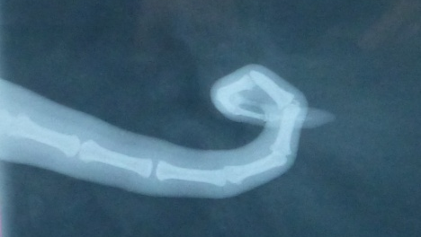
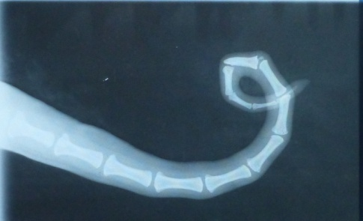
Because the Wetterhoun carries his tail in a ring, the tailbones, muscles and ligaments will grow differently so be careful if you write something about a kinked tail.
You can’t judge that without x-ray eyes.

Slide 49
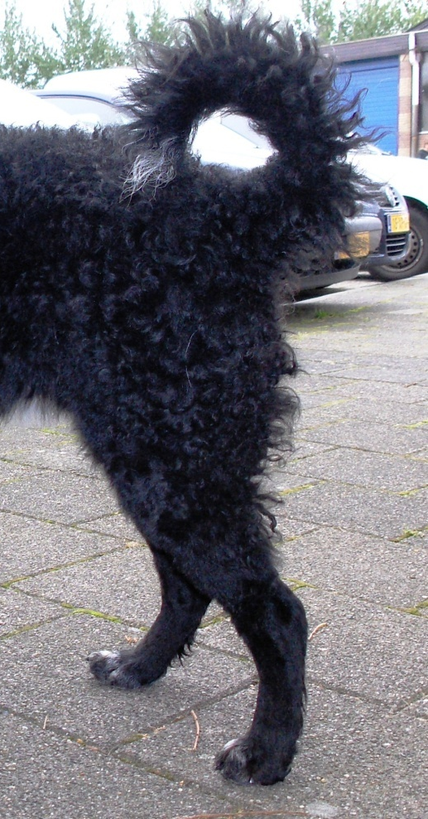
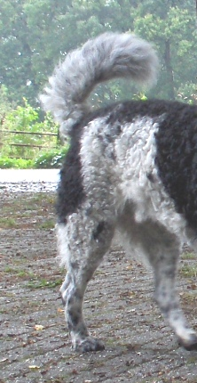
Open tail (less desirable) and gay tail (not good)

Slide 50
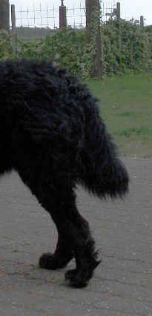

The tail shows the mood of the dog.
When they are in the show ring,
They might be a bit uncomfortable
and let the tail hang straight.
Sometimes you can see a little
hole in the coat where the tail
should lay down on the back.
This can be an indication for a
good tail carriage.
Here are two tailsets from the same dog

Slide 51
LIMBS
Forequarters
Shoulders : Shoulder blade, well-laid against the chest; obliquely placed and well angulated.
Forearm : Powerful and straight.
Pasterns : Straight, not obliquely set.
Fore feet : Round, toes well developed and arched, pads thick.

Slide 52

Forequarters
Well angulated can be taken more as moderately angulated.
With this, the angulations of the front are harmonically proportioned with the hindquarters.

Slide 53

Hindquarters
Powerful, moderately angulated.
Lower thigh : Not too long.
Hock joint : Placed low.
Rear pasterns : Short.
Hindfeet : Round with well developed pads.

Slide 54
Coat
HAIR :
With the exception of the head and legs, the body is
covered with tight curls consisting of firm, strong
tufts of hair.
Sparse curls or curls of thin hair tufts give the dog a
woolly appearance, which must be considered a
serious fault.
The coat itself is rather coarse in texture and has
a greasy touch.

Slide 55

Tight curls consisting of firm tufts.
The hair is coarse and feels greasy.

Slide 56



Too wooly Not enough curl Open curls

Slide 57
Sometimes we see bald spots that are usually symmetric.
(on the rear, at the sides or chest, neck and the back of the ears)
This used to be a problem with the Wetterhoun.
Although, we don’t really know the reason,
we don’t see it very often anymore.
)

Slide 58
Coat
COLOUR :
Solid black or brown, or black with white markings,
or brown with white markings.
Ticking or roan in the white are permitted.

Slide 59

White with black marking White with black marking
and ticking with little ticking

Slide 60


White with brown marking Solid black and brown
and little ticking with little marks on chest
The small white marks are not a problem, also a bit white on the tones

Slide 61
There are dogs that are predominantly colored, as well as
dogs that have only a colored face and a colored patch at the
tail set (or even without the colored tail set).
You also will find the ticking or spots in different degrees,
from none to a completely grey dog.
All these combinations are allowed in our breed. We may
prefer a completely black or brown head, but a blaze or small
patch is not considered a fault.

Slide 62


Almost white or heads with blazes; they are both allowed,

Slide 63

Rarely we see tricolors. This color is not allowed in the breed standard.
Tricolor (tan) we can find on the legs, at the inner side of the ears,
above the eyes and/or under the tail.
How small the spot is does not matter;
only one little spot is enough to be declared as a tricolor.

Slide 64
Size
Ideal size for dogs: 59 cm.
Ideal size for bitches: 55 cm.
When the dog is well balanced though, he is forgiven for being a little too small or too high. After all it is an ideal size .

Slide 65
Movement:
The movement is discussed in the breed standard.
If we may make a proposal, it would be this:
    Powerful, with sufficient drive.
    When viewed from the front, the Wetterhoun
    moves quite broad.
    During movement, the head is a bit above the topline.
    Tendency to be ambling in gait.

Slide 66

At this moment, there are no disqualifying faults, other than the behavior and the absence of one or two testicles in a male.

Slide 67
The major faults that the judges should be aware of are:
      Too heavy or just too elegant
      Heads, too heavy or with snipey muzzles
      Front placed too far forward
      Low legged
      Pelvis too straight

Slide 68


Curly coated Retriever

Slide 69

Irish Water Spaniel

Slide 70

Barbet

Slide 71


Not really used for developing the Wetterhoun, but because of the
crossbreeding done in the beginning of the 20th century, we see still the
influence of the Stabijhoun in the Wetterhoun. (Tail, head, eyes,)
Stabijhoun

Slide 72

Health problems
There are no health problems to take into account when judging. Sometimes we see improperly fitting eye lids.
For breeding, they must be tested in Holland for the hips and SCID (Severe Combined Immune Defiency Syndrome).
Epilepsy, heart problems and elbows are also sometimes seen in the breed.

Slide 73
Behaviour problems
The Wetterhoun can be a bit wary and shy in the beginning. Don’t start with bending over the dog to judge him, but first let him get use to you by smelling your hand.
We rarely see aggressive dogs.

Slide 74
Movement is not a problem.
They don’t move fancy and because of the broad chest, they can be a little broad in front. The elbows must be close to the chest. Quite often they are too loose.
Because of the square body proportions, they easily move in a pace.

Slide 75

Thank you for your time in learning about judging the Wetterhoun!

